Slide 1


URL Shortener
CS 5610
Introduction to Cloud Computing
Team Members xxxxxx-700xxxxx
xxxx-700xxxxxx

Slide 2
Agenda
Introduction
Cloud Technologies
Project Flow
ScreenShots and Outputs

Slide 3
Introduction
In an era of sprawling and complex URLs, our project addresses the need for simplicity.
The introduction of an expiration feature adds a touch of security, ensuring that our shortened URLs have a limited timeframe.
Hosted on Amazon S3, our user-friendly web interface provides a straightforward platform for managing URLs seamlessly.
Let's dive into the efficiency and simplicity of our URL shortener project.

Slide 4
Applications
Social Media Sharing: Ideal for platforms with character limits like Twitter.
Email Marketing: Maintains a clean appearance in email campaigns.
QR Codes: Simplifies QR codes for easy scanning.
Tracking and Analytics: Provides insights into link engagement.
Link Management: Facilitates easy updates and redirection.
Affiliate Marketing: Efficient for managing and tracking affiliate links.
Branding: Creates branded and aesthetically pleasing links.
Mobile Marketing: Effective in campaigns with SMS character limits.
Reducing Errors: Minimizes typing errors for complex URLs.
Podcasts and Print Media: Presents cleaner links for non-digital formats.

Slide 5
Architecture Overview
Serverless Paradigm
Embracing the serverless paradigm, our project utilizes AWS services—Lambda, DynamoDB, and API Gateway—for scalable and cost-effective execution.
AWS Services: Lambda, DynamoDB, API Gateway
Lambda Functions: Powering URL shortening and redirection processes.
User-Friendly Web Interface on Amazon S3
Hosted on Amazon S3, our user-friendly web interface ensures scalability and reliability for an optimal user experience.
DynamoDB: Securely stores URL mappings with fast retrieval.
API Gateway: Unifies HTTP requests for seamless integration with Lambda functions.

Slide 6

Lambda Functions
URL Shortener Lambda:
Redirection Lambda:
Generates Unique Short Keys: Utilizing Base62 encoding, this function creates unique short keys for efficient URL representation.
Constructs Short URLs: Combining the generated short key with the API Gateway endpoint, our URL shortener lambda constructs short URLs.
Stores Data in DynamoDB: The function securely stores essential data, including the short key, short URL, long URL, and expiration date, in DynamoDB.
Retrieves Long URLs: This function retrieves long URLs from DynamoDB based on the short key provided in the request.
Seamless URL Redirection: Facilitating seamless redirection, the lambda ensures users are directed to the original long URL with minimal latency

Slide 7

DynamoDB Overview
Role: DynamoDB serves as our scalable NoSQL database, storing crucial URL mappings.
Attributes:
shortkey: Unique identifier generated for short URLs.
shortURL: Constructed URL for user accessibility.
longURL: Original user-provided long URL.
ExpirationDate: Timestamp for URL expiration.
Performance: Ensures fast and consistent retrieval.

Slide 8

API Gateway Overview
Configuration:
REST API (URL Shortener): Handles shortening requests.
HTTP API (Redirection): Manages URL redirection.
Unified Entry Point:
API Gateway serves as a single entry point, efficiently connecting our web interface with Lambda functions.
Seamless Integration:
Ensures smooth communication between client requests and serverless functions.

Slide 9

Amazon S3
Role:
Amazon S3 hosts our user-friendly web interface.
Benefits:
Scalability: Adapts seamlessly to varying traffic.
Reliability: Ensures consistent availability.
Efficient Content Delivery:
Utilizes static web hosting for optimized content delivery.

Slide 10
Workflow
URL Shortener Lambda:
User Inputs Long URL
URL Shortener Lambda Generates Short Key
Shortened URL and Data Stored in DynamoDB
Redirection Lambda:
User Accesses Shortened URL
Redirection Lambda Retrieves Long URL
Seamless Redirection Based on Expiration

Slide 11
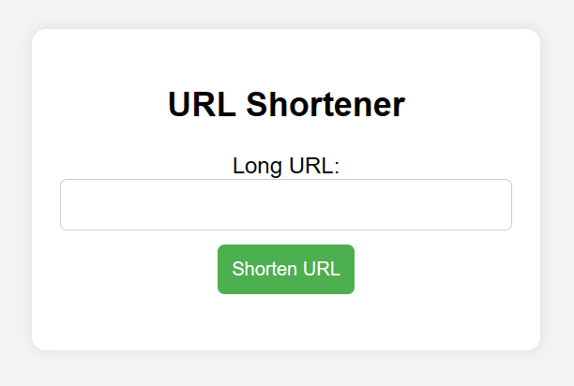
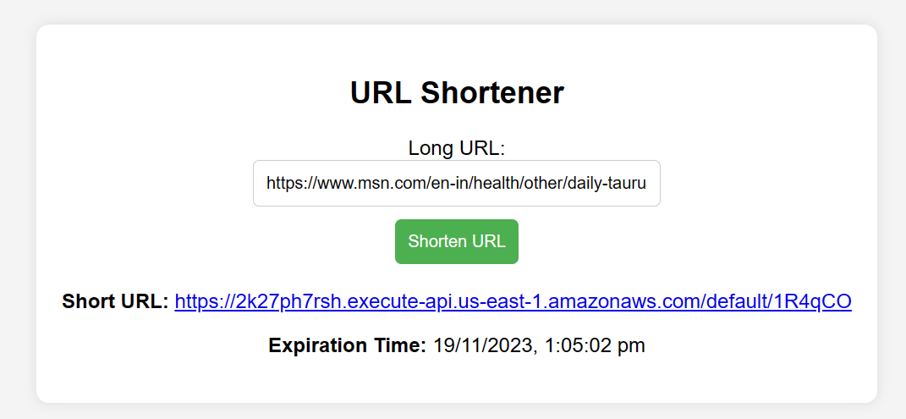
A user inputs a long URL through the user-friendly web page hosted on Amazon S3.
The URL Shortener Lambda generates a unique short key and constructs a short URL.
This information is then stored in DynamoDB, including an expiration timestamp set to the default of 24 hours.
When a user accesses a shortened URL, the Redirection Lambda retrieves the associated long URL from DynamoDB.
If the URL is still valid based on the expiration timestamp, the user is seamlessly redirected to the original long URL.

Slide 12
Limitations and Considerations
Domain Name Constraints:
Due to limited access to domain names, our project utilizes the API Gateway domain for constructing shortened URLs. While this ensures a functional solution within our academic environment, it's essential to note this constraint in the context of our project.
Expiration Feature:
By default, shortened URLs are set to expire after 24 hours.
This adds an additional layer of security to the URLs.

Slide 13

Thank you

